Slide 1
Research

Slide 2
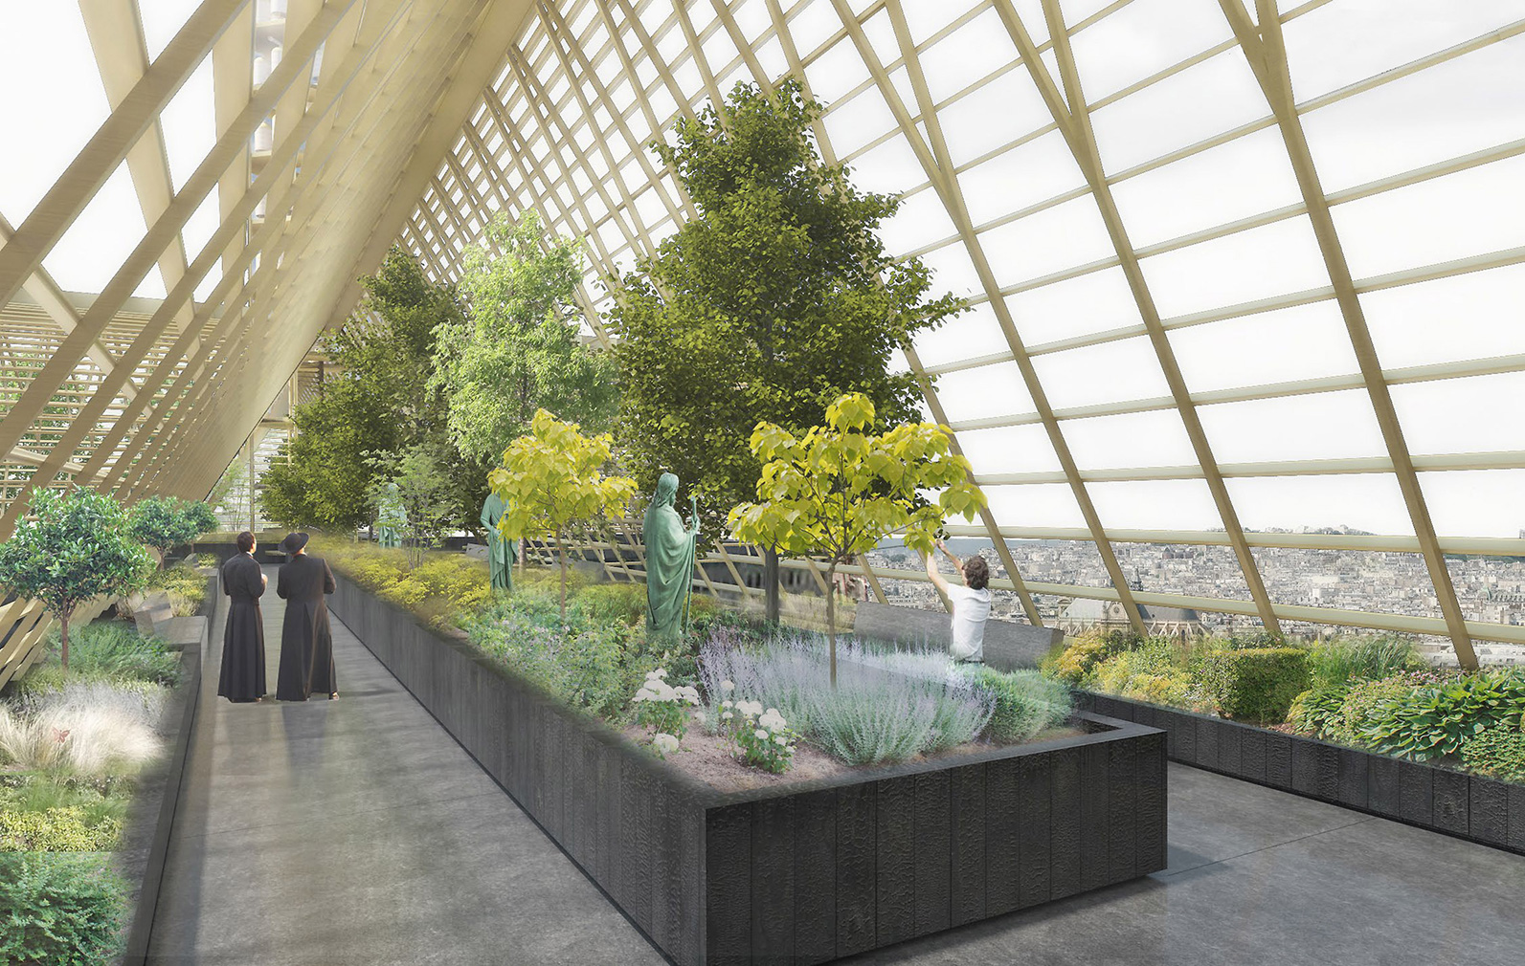
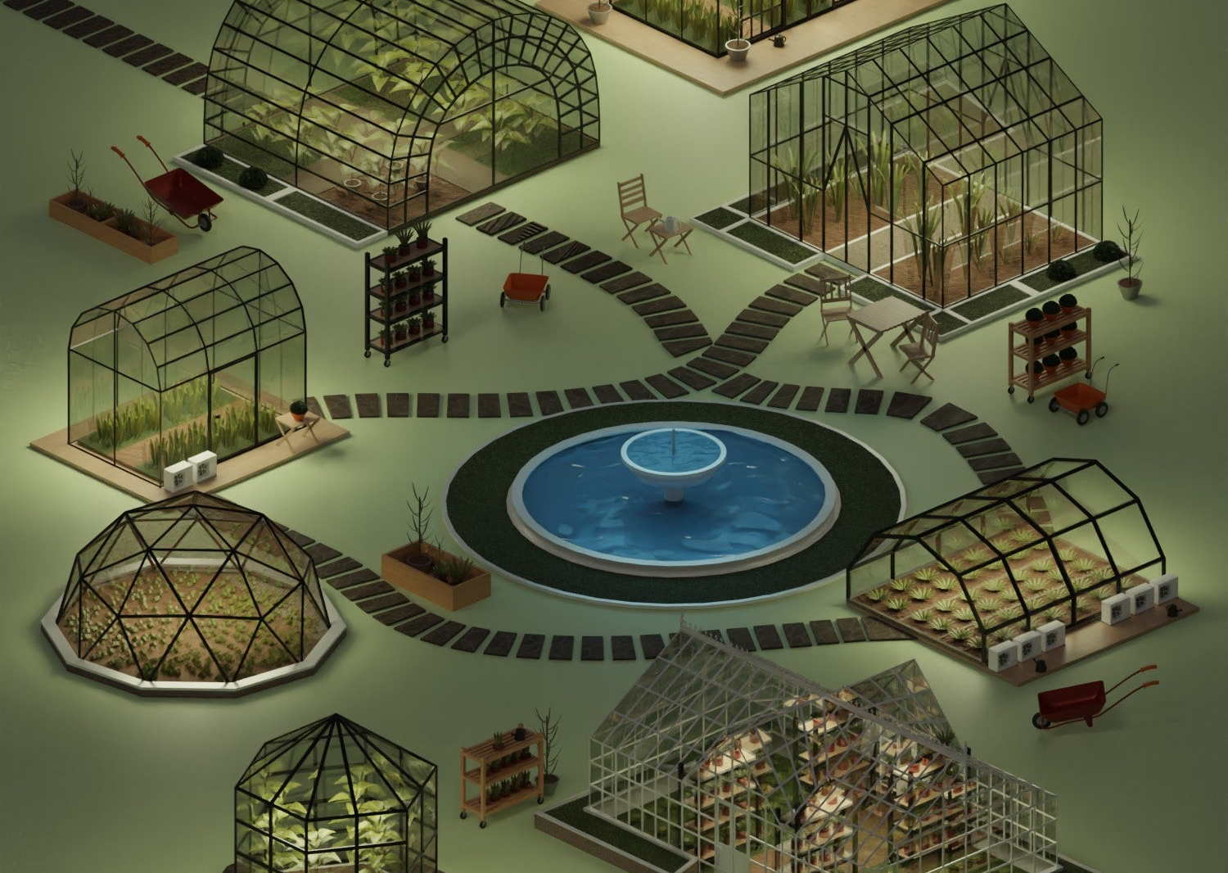
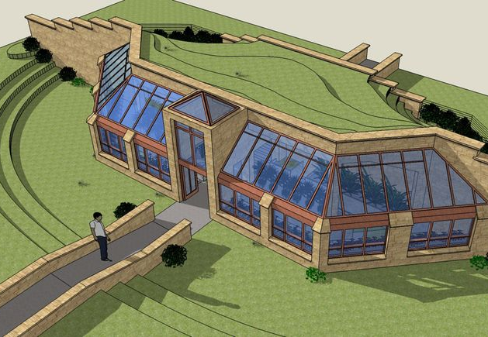
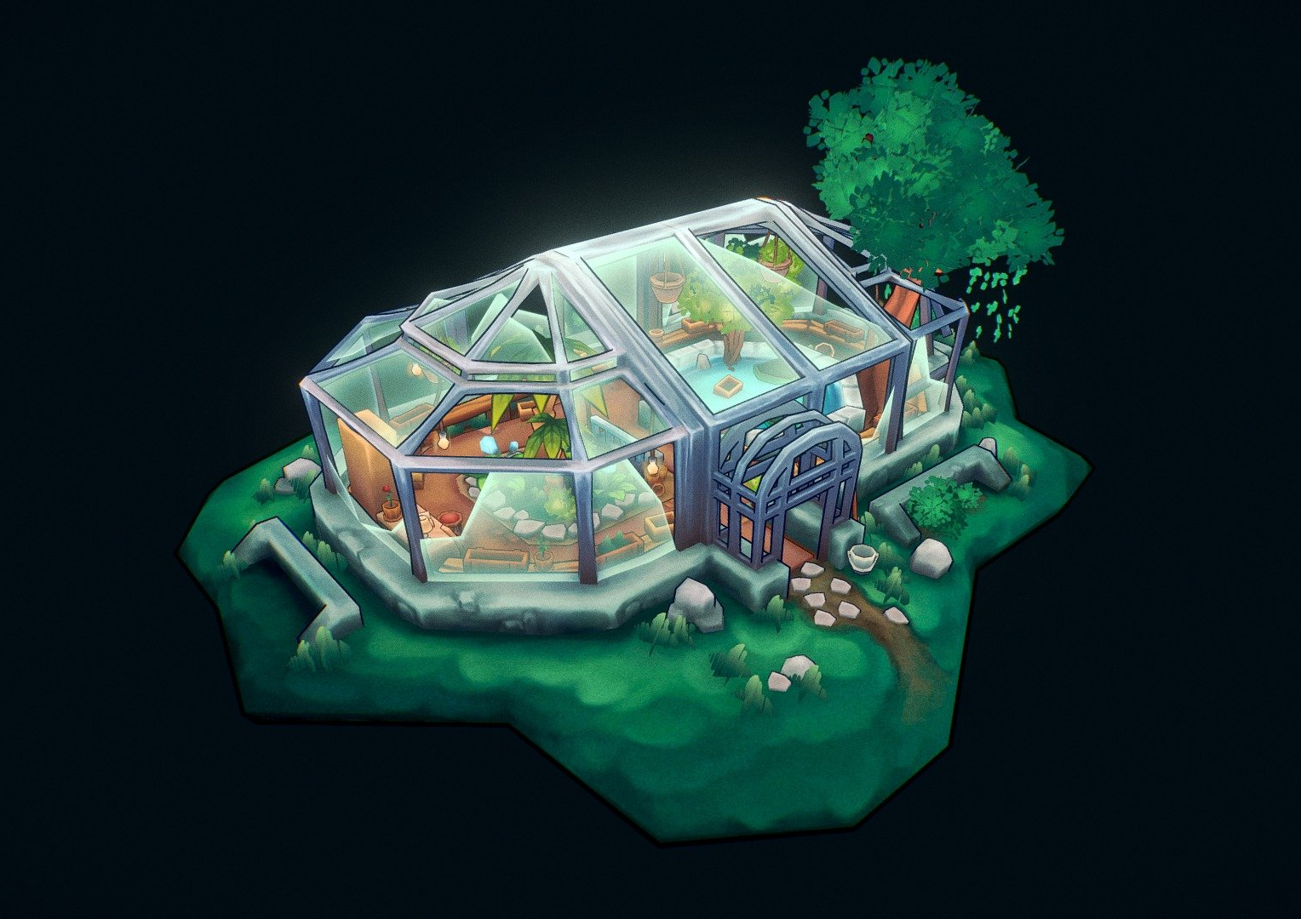
Environment
These are models of greenhouses, I will be taking inspiration from these in how I create the environment for my game, most of them use rectangular windows to form the shape they are looking for I will use rectangular windows too to build up the shape and for the interior there are a lot of mutated plants and greenery around. I will also have some smashed windows around to add to the atmosphere more. There will be smashed glass on the floor and other bits of rubble and debris around to help fill out the environment and limit the players movement slightly so the game isn’t too easy for the players

Slide 3
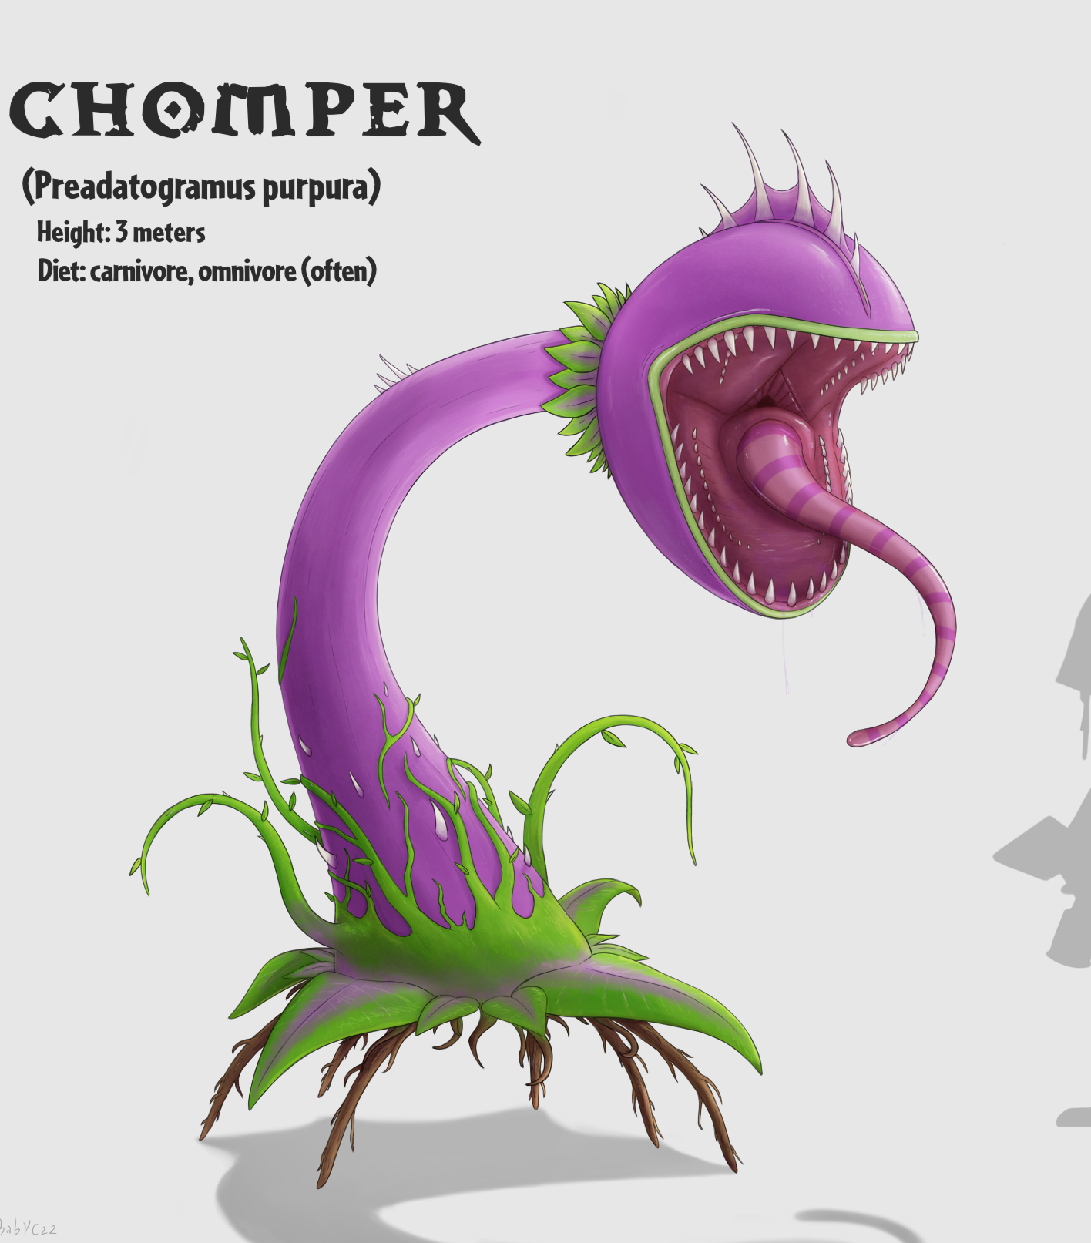

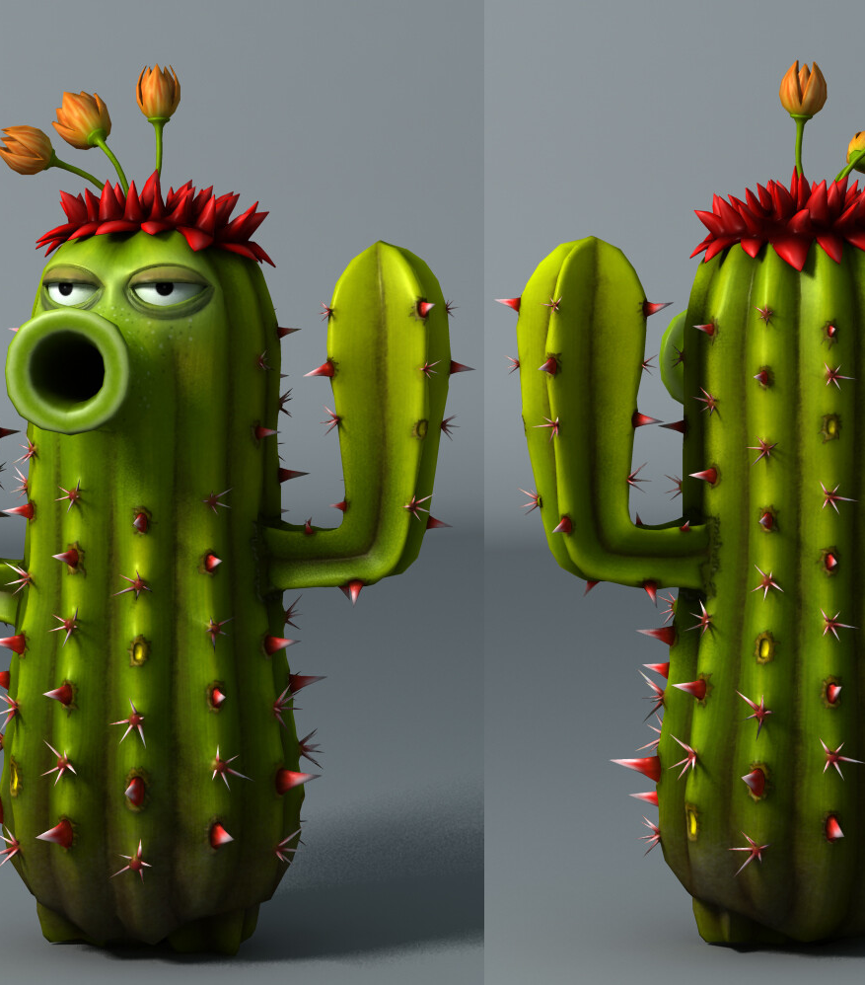
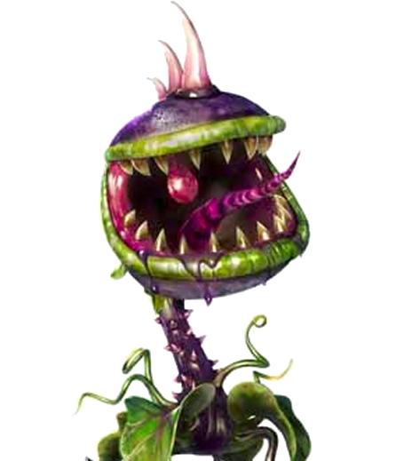
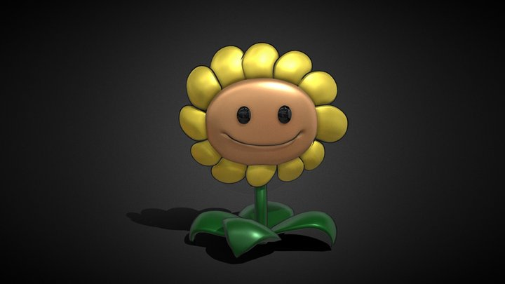
Plants
In these designs they all follow a similar style for a generalized living plant design. I like the style of a plant with sharp teeth. I will be using a similar cartoony art style my designs will feature traditional animal features such as eyes and noses to make the plants feel more human and alive. These need to look fairly menacing as they will be helping the player kill gnomes and survive. These plants will be a direct help to the players survival

Slide 4
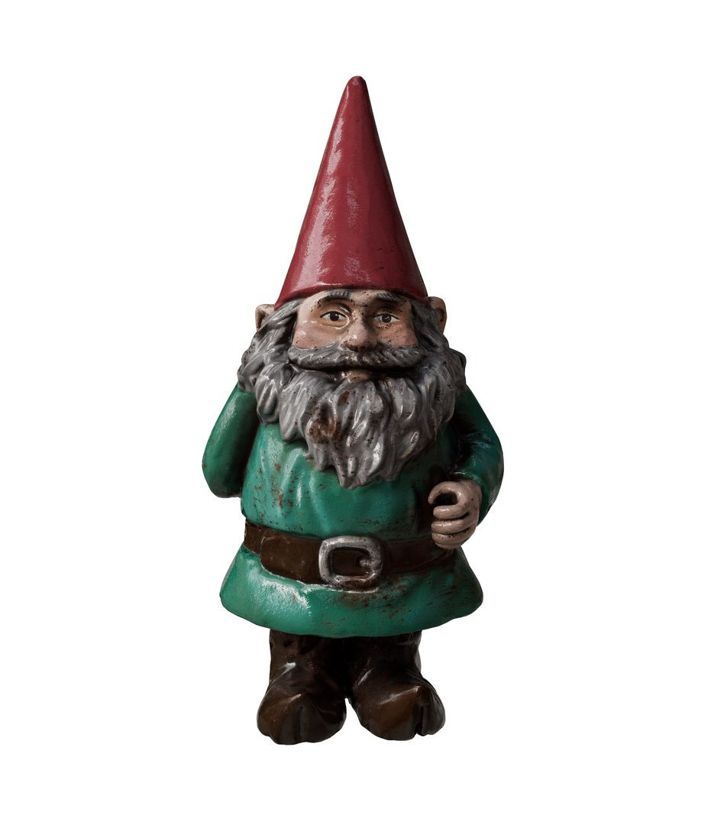
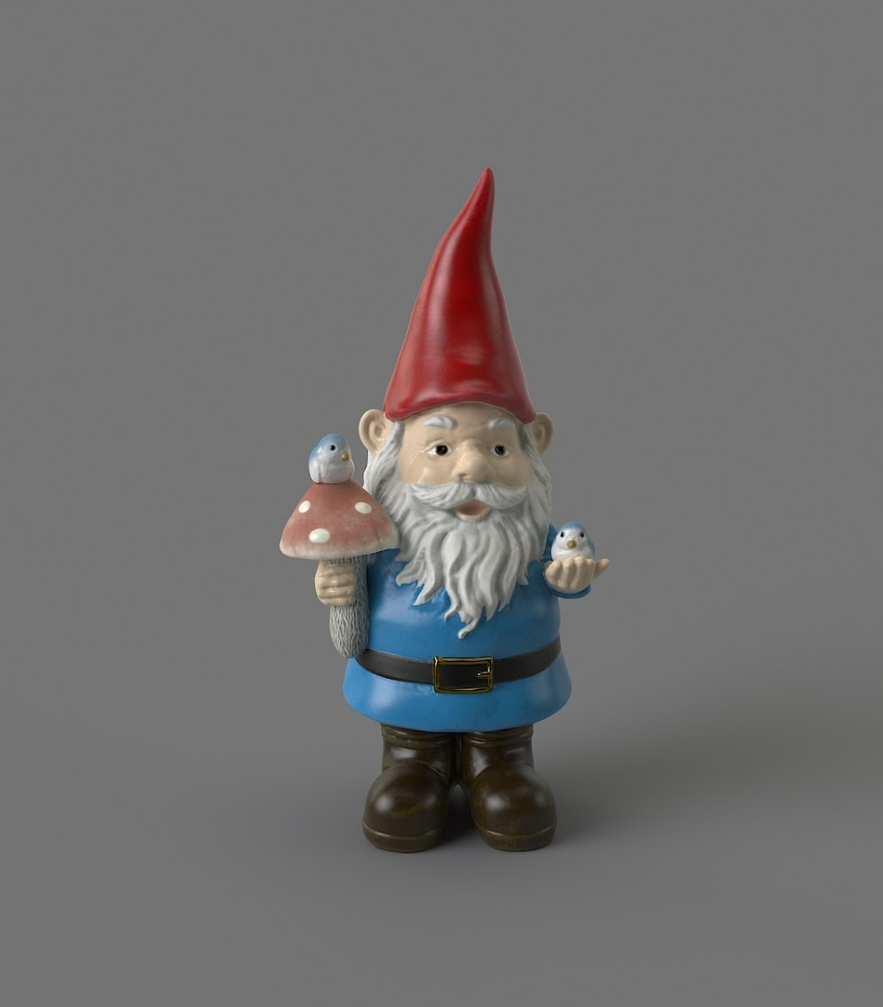
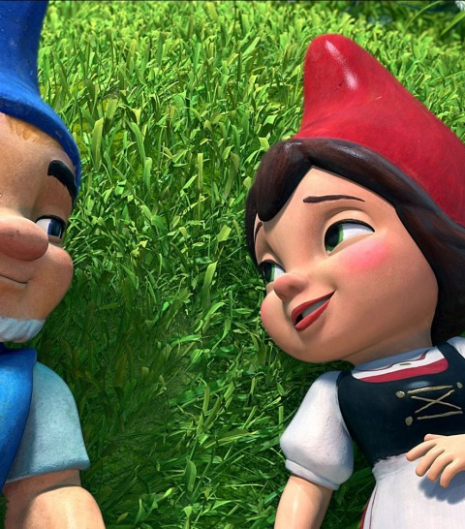
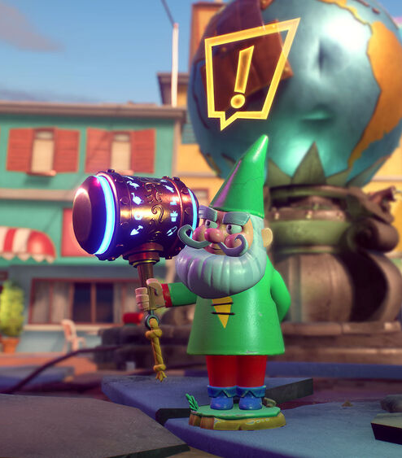
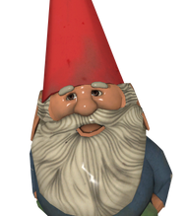
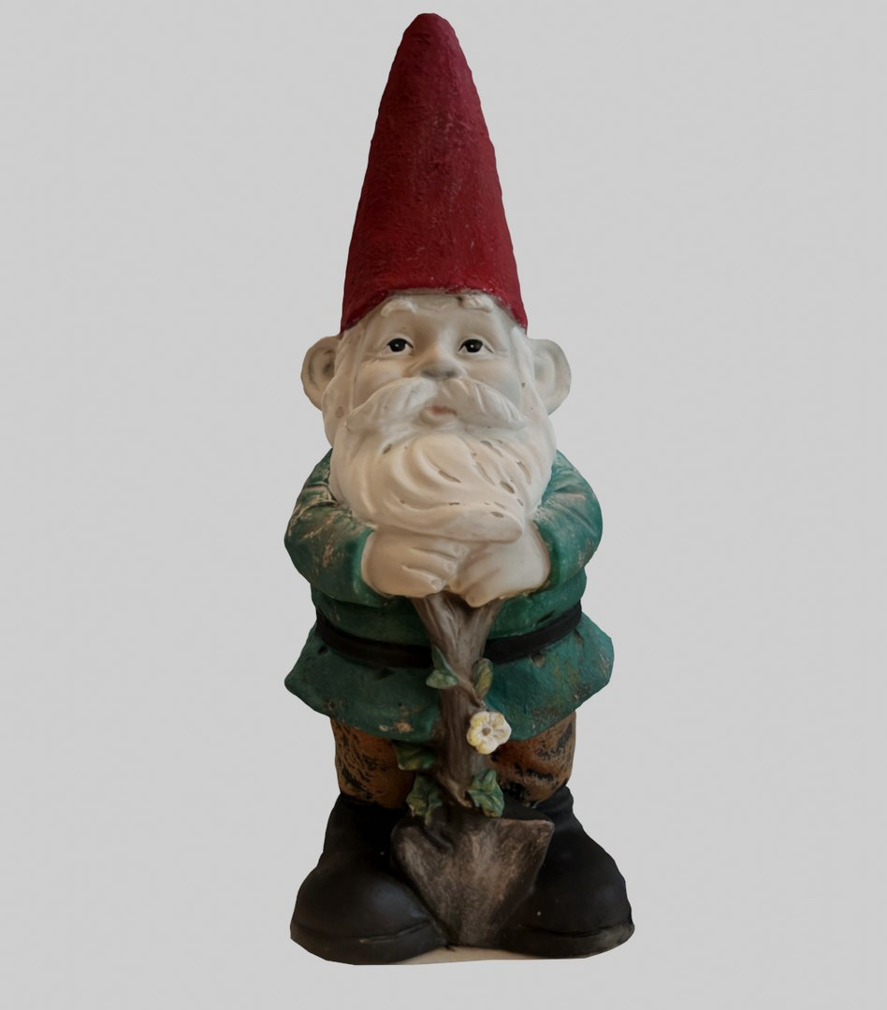
Gnomes
This is a bunch of gnomes that I am taking inspiration from, it is important for me to include the pointy red hat as all of the gnomes in this style have them. As well as this most of them have belts so I will include this too. These gnomes will the the main antagonist of the game and will constantly be trying to kill the player, this makes it a highly important asset in my game so I am planning to make 3 different gnomes so not every enemy looks and feels the same as eachother

Slide 5
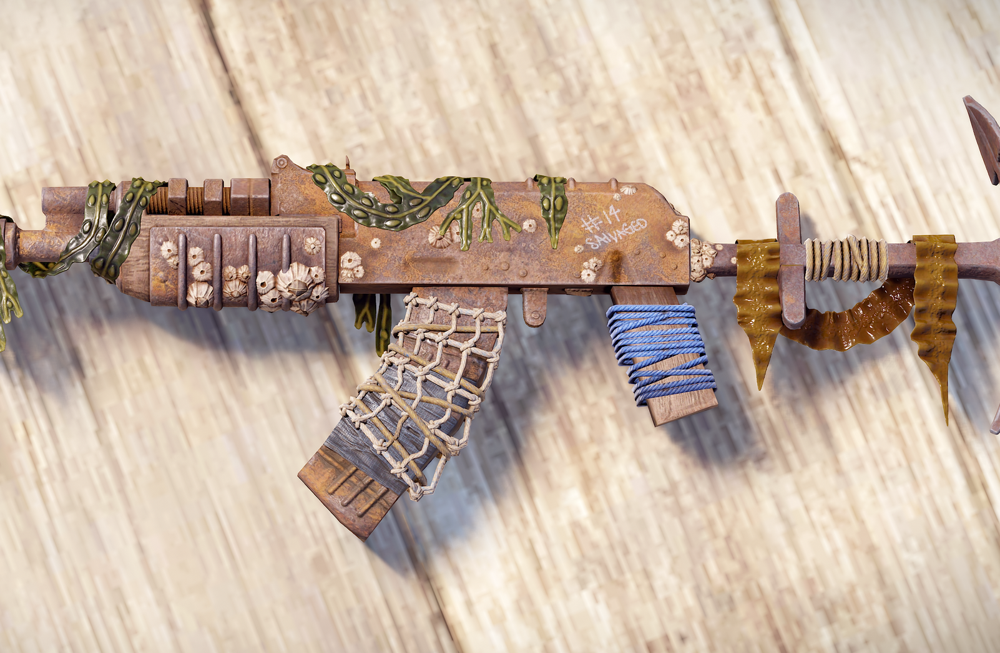
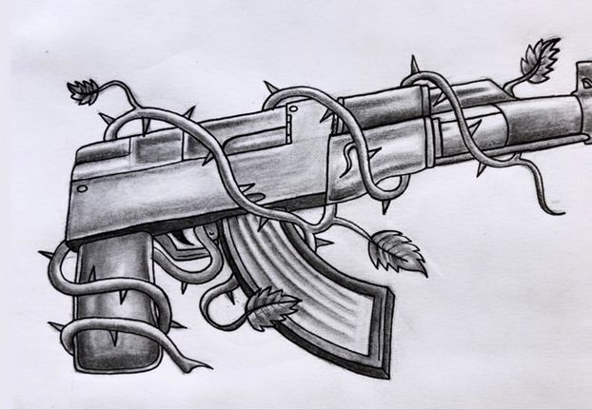
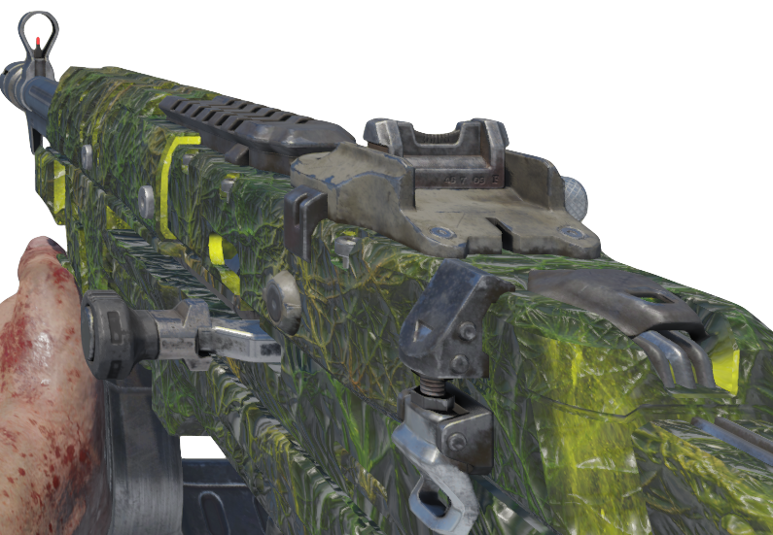
Guns
These guns have a specific look to them where vines wrap around the gun this is similar to how my upgraded guns will look in game, they will have a panning texture similar to black ops 3 zombies as a base color for the gun and will have 3d vines wrap around the gun. The assault rifle will be the main gun that the player will use. The player will start with a pistol that can be upgraded but the players will want to get the higher powered assault rifle so they can reach later rounds. Both the guns upgrades will be a similar design consisting of the vines growing around it and the panning texture

Slide 6
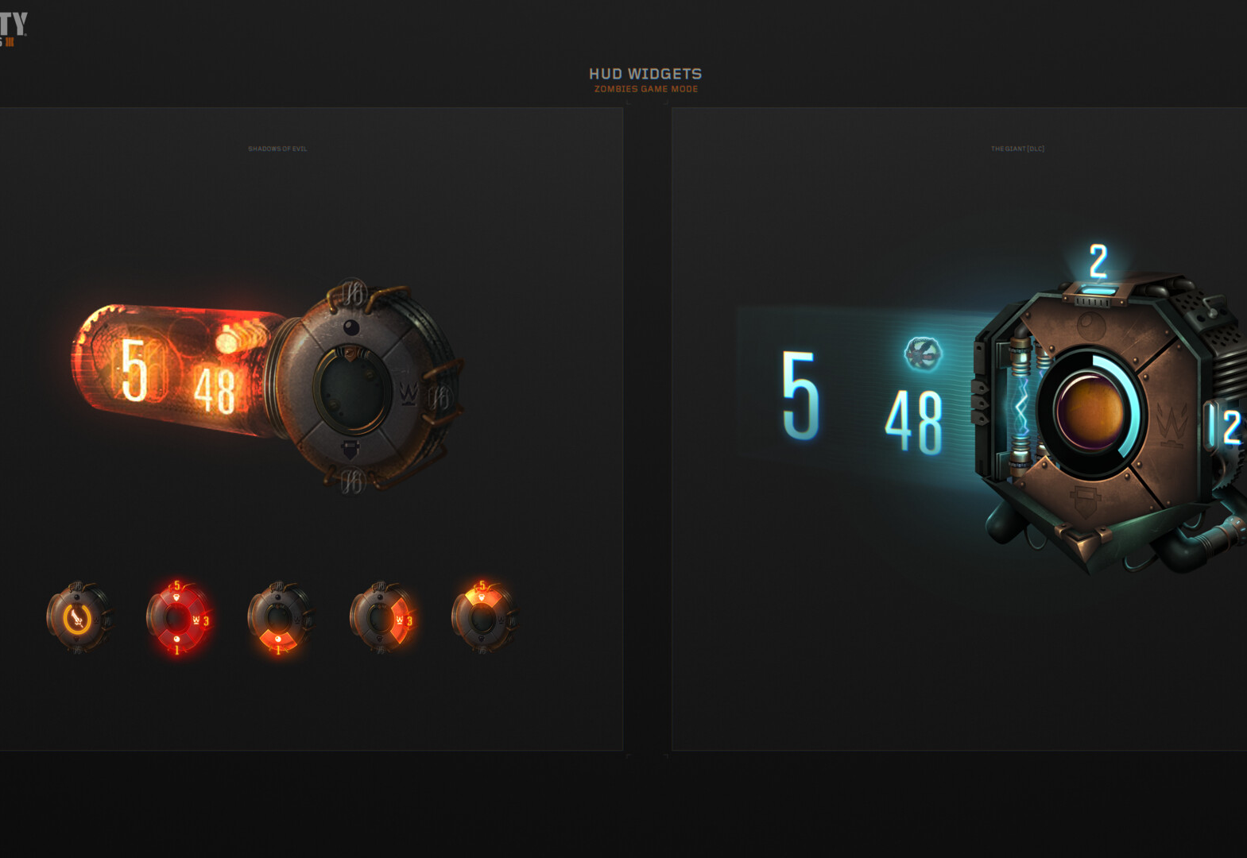
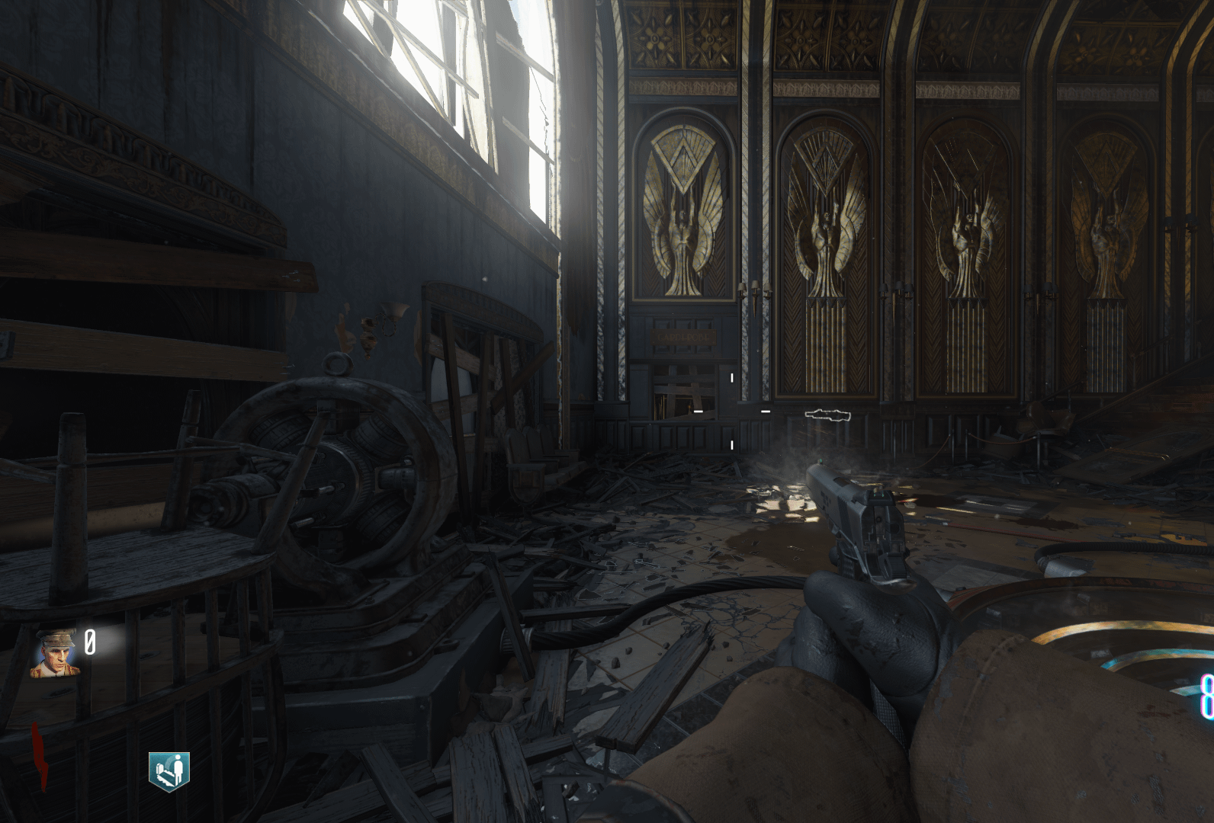
UI
I will have a similar UI to Black ops 3 zombies consisting of a points counter, round counter and ammo counters my UI will be layer out differently and none useful information will only stay on screen for a short time such as the name of the gun being held, this only needs to display when changing to a new gun rather than at all times this is to help make the UI feel clean and not overwhelm the player with too much information that they don’t need

Slide 7
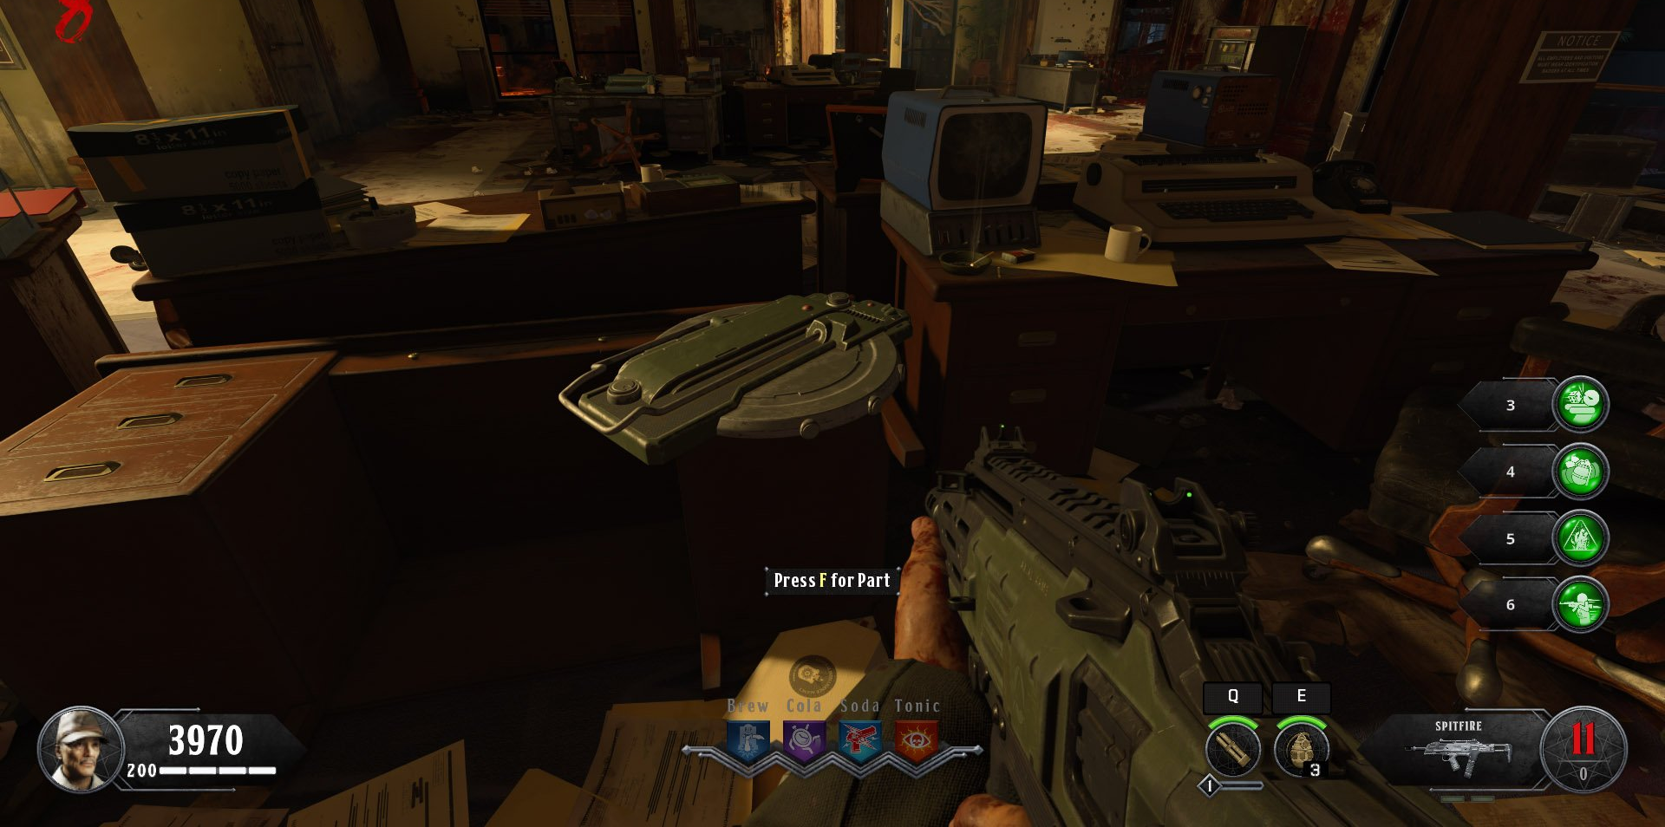
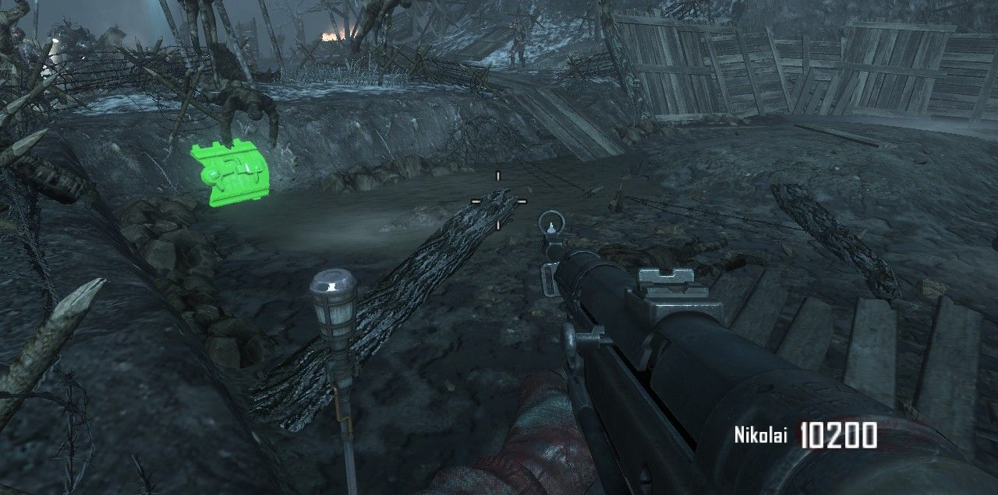
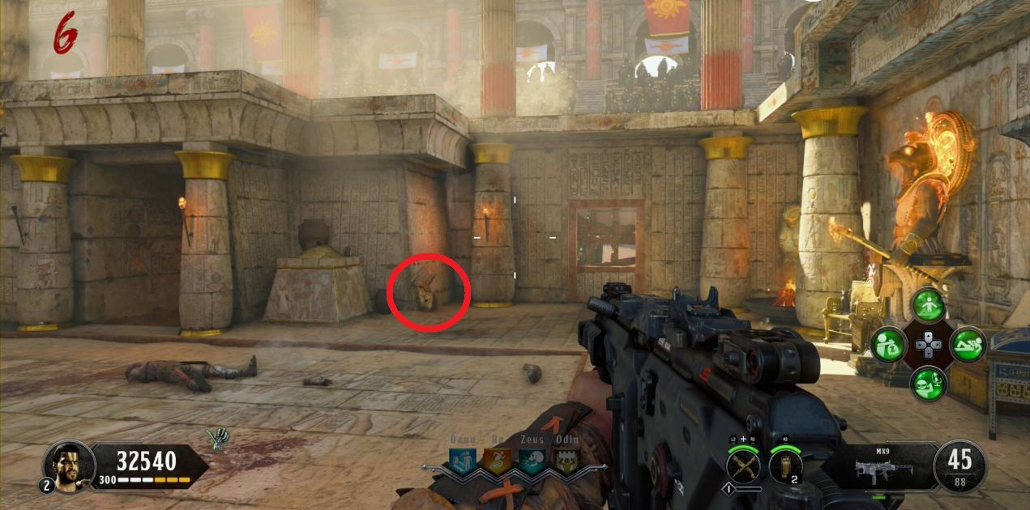
interactables
My game will have interactable seeds around the map that the player can find and use to plant the plants that will help the player to survive as the rounds go on. They will be found in the environment where the player will be able to interact with them and pick them up. In the images they are highlighted in my game however they will not be, I want the player to feel rewarded when they find a new seed in the map, by obviously showing them to the player this sense of reward is lowered. I will give the items a brighter coloured outline than the world when a player is close to help them however this will be faint and hard to see so its not too obvious to the player

Slide 8
Bibliography
Anon, 3D Garden Gnome - TurboSquid 1930955 [online]. Turbosquid.com. Available at: https://www.turbosquid.com/3d-models/3d-garden-gnome-1930955 [Accessed 20 October 2023 a].
Anon, 3D garden gnome model - TurboSquid 1223072 [online]. Turbosquid.com. Available at: https://www.turbosquid.com/3d-models/3d-garden-gnome-model-1223072 [Accessed 20 October 2023 b].
Anon, 3D model greenhouse [online]. Toffu Co. Available at: https://toffu.co/en-at/products/3d-model-greenhouses [Accessed 20 October 2023 c].
Anon, Botnomorphia: Chomper [online]. Deviantart.com. Available at: https://www.deviantart.com/kittygirlxjanax/art/Botnomorphia-Chomper-927352999 [Accessed 13 October 2023 d].
Anon, Earthship greenhouse designs [online]. Pinterest. Available at: https://www.pinterest.com/pin/64950419602135747/ [Accessed 20 October 2023 e].
Anon, Garden Gnome With Open Hand 3D - TurboSquid 1972477 [online]. Turbosquid.com. Available at: https://www.turbosquid.com/3d-models/garden-gnome-with-open-hand-3d-1972477 [Accessed 20 October 2023 f].
Anon, Gnome Chompski [online]. Left 4 Dead Wiki. Available at: https://left4dead.fandom.com/wiki/Gnome_Chompski [Accessed 20 October 2023 g].
Anon, Mr. Lucky [online]. Plants vs. Zombies Wiki. Available at: https://plantsvszombies.fandom.com/wiki/Mr._Lucky [Accessed 12 November 2023 h].
Anon, Pin on housebabytattoo [online]. Pinterest. Available at: https://www.pinterest.com/pin/housebabytattoo--664562488764151020/ [Accessed 3 November 2023 i].
Anon, PVZ Plant Character Models, Gordon Wang [online]. ArtStation. Available at: https://www.artstation.com/artwork/KO208X [Accessed 12 November 2023 j].
Anon, Steam Community :: Guide :: Tier list for all the weapons in BO III Zombies [online]. Steamcommunity.com. Available at: https://steamcommunity.com/sharedfiles/filedetails/?id=758313788 [Accessed 3 November 2023 k].
Anon, 2022. Stylized Mangrove Greenhouse - Download Free 3D model by Bársh (@borsh_and) [eBook]. Available at: https://sketchfab.com/3d-models/stylized-mangrove-greenhouse-4ad533f838f44fa583683ab7939c6aa1 [Accessed 20 October 2023].
Anon, 2021. Sunflower (Plants vs. Zombies) - Download Free 3D model by KillerBear [eBook]. Available at: https://sketchfab.com/3d-models/sunflower-plants-vs-zombies-a5a7d590bd0a4288b489c1421aa59c14 [Accessed 20 October 2023].
Anon, Nocookie.net. Available at: https://static.wikia.nocookie.net/gardenwarfare_gamepedia/images/3/3e/Chomper_front.PNG/revision/latest/scale-to-width-down/275?cb=20160224122152 [Accessed 13 October 2023 l].
Anon, Plutonium.pw. Available at: https://forum.plutonium.pw/topic/16186/bo2-zombies-ez-2-see-parts-origins-retexture [Accessed 12 November 2023 m].
Bugs, 2023. Abyss update preview — [online]. Rustafied. Available at: https://www.rustafied.com/updates/2023/6/29/abyss-update-preview [Accessed 3 November 2023].
Chandler, S., 2018. How to unlock the Pack-a-Punch in Classified - Call of Duty: Black Ops 4 Zombies [online]. Shacknews. Available at: https://www.shacknews.com/article/107974/how-to-unlock-the-pack-a-punch-in-classified-call-of-duty-black-ops-4-zombies [Accessed 12 November 2023].
CriesOfFurya, 2018. COD Black Ops 4: IX - How to Build the Zombie Shield [online]. PowerPyx. Available at: https://www.powerpyx.com/cod-black-ops-4-ix-how-to-build-the-zombie-shield/ [Accessed 12 November 2023].
Duran, M., Black Ops III : Zombies Game Mode UI, Miguel Duran [online]. ArtStation. Available at: https://www.artstation.com/artwork/rJzL9e [Accessed 12 November 2023].
EA, 2016. plants vs zombies garden warfare 2 [eBook]. Available at: https://store.steampowered.com/app/1922560/Plants_vs_Zombies_Garden_Warfare_2_Deluxe_Edition/.
Into Film, Gnomeo and Juliet [online]. Intofilm.org. Available at: https://www.intofilm.org/films/16615 [Accessed 3 November 2023].

